Slide 1
Unit 3 Model evaluation
Evaluating Regression Models
Model Selection
Bagging
Ensemble Methods.
Up until 2005… humans had created 130 exabytes of data

Slide 2
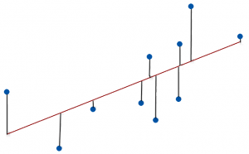
Residual plots for regression model evaluation
Residuals
The residual data of the simple linear regression model is the difference between the observed data of the dependent variable y and the fitted values ŷ.
Residuals = Observed value – Fitted value

Slide 3
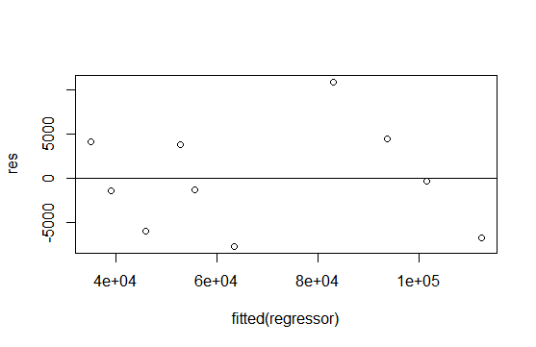
Residual plot
A graph that shows the residuals on the vertical axis and the independent variable on the horizontal axis

Slide 4
How to check residual plot
When looking at residual plots, you simply want to determine whether the residuals are consistent with random error, check that they are randomly scattered around zero for the entire range of fitted values.
When the residuals center on zero, they indicate that the model’s predictions are correct on average rather than systematically too high or low
(0,0)

Slide 5
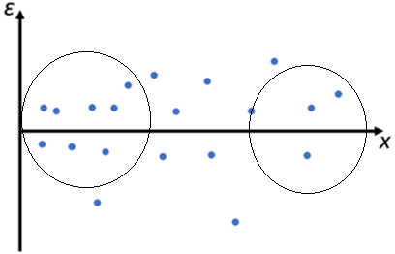
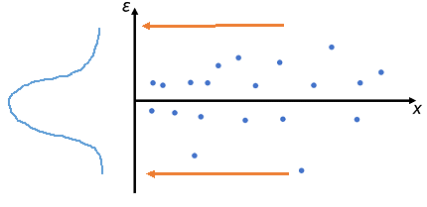
Characteristics of Good Residual Plots
A few characteristics of a good residual plot are as follows:
It has a high density of points close to the origin and a low density of points away from the origin.
It is symmetric about the origin
High Density
Low Density

Slide 6
In-sample evaluation :
tells us how well our model will fit the data used to train it
It does not tell us how well the trained model can be used to predict the values
Out-sample evaluation :
used to approximate how the model will perform in the real world

Slide 7
For model evaluation we split the data into training set and test set.
Training set
A larger portion of the data can be used to train the model
Test Set
A smaller portion of the data can be used to test the predictive accuracy of the model
In R language sample.split function is available to split the dataset into training set and test set.

Slide 8
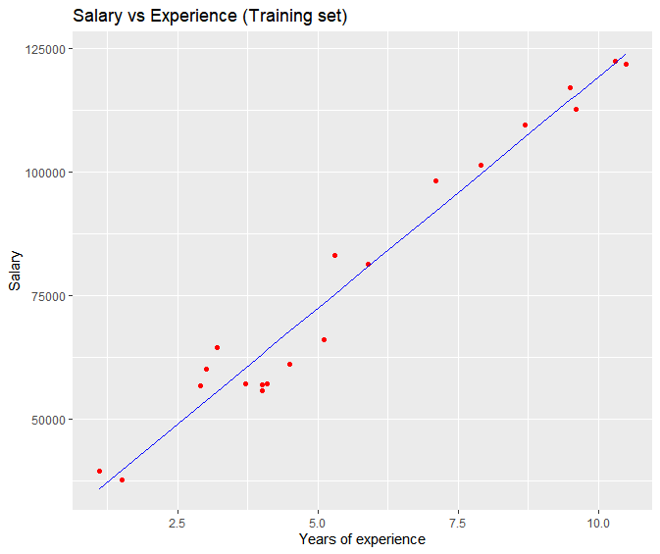
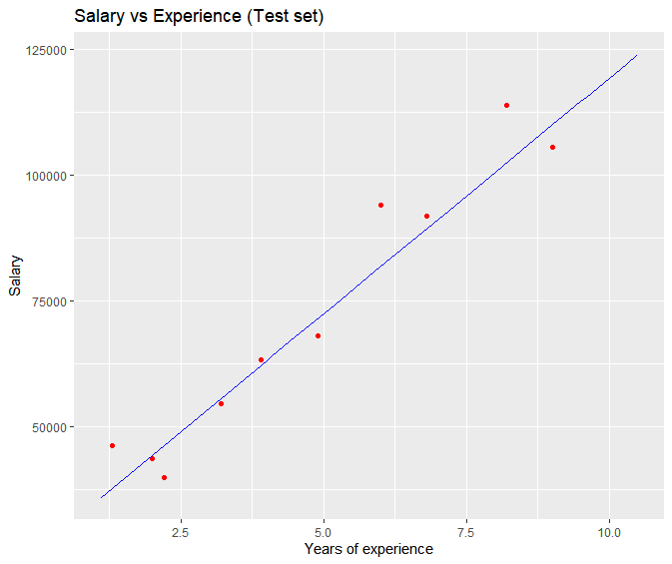
Can training set error will indicate the generalization error?
the training set error isn’t indicative of the model error when applied to new data

Slide 9
Generalization Error
In supervised learning applications in machine learning and statistical learning theory, generalization error (also known as the out-of-sample error) is a measure of how accurately an algorithm is able to predict outcome values for previously unseen data.
The error we obtain using our testing data is an approximation of this error
The gap between predictions and observed data is induced by model inaccuracy, sampling error, and noise.
Choosing the right algorithm and tuning parameters could improve model accuracy, but we will never be able to make our predictions 100% accurate.
Notes:
When we train a machine learning model, we don’t just want it to learn to model the training data. We want it to generalize to the data it hasn’t seen before. Fortunately, there’s a very convenient way to measure an algorithm’s generalization performance: we measure its performance on a held-out test set, consisting of examples it hasn’t seen before. If an algorithm works well on the training set but fails to generalize, we say it is overfitting.

Slide 10
Components if generalization error
Bias
Variance
Underfitting
Overfitting

Slide 11
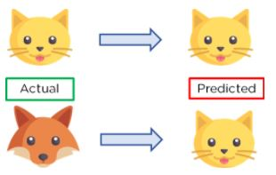
Variance
variance is an algorithm’s flexibility to learn patterns in the observed data.
Variance is the amount that an algorithm will change if a different dataset is used.
A model is of high variance when, for instance, it tries too hard that it not only captures the pattern of meaningful features but also that the meaningless error (overfitting).

Slide 12
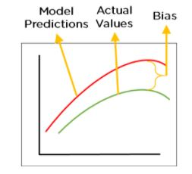
Bias
Bias is measured by the differences between the expected predicted values and the observed values
Bias is the simple assumptions that our model makes about our data to be able to predict new data.
When the Bias is high, assumptions made by our model are too basic, the model can’t capture the important features of our data.
This means that our model hasn’t captured patterns in the training data and hence cannot perform well on the testing data too. If this is the case, our model cannot perform on new data and cannot be sent into production.

Slide 13
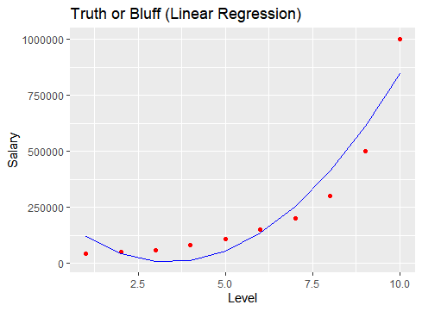
Uderfitting
When a model is unable to capture the essence of the training data properly because of a low number of parameters then this phenomenon is known as Underfitting
High bias error, Low variance error, high error rate in the training data
Very less amount of data to build the model
Since our model performs badly on the training data, it consequently performs badly on the testing data as well.

Slide 14
Summary
Model has high bias , failed to learn important patterns in the data , and when used with new data set will give underfitting
Model has high variance , trying to be nice to training data , trying to model everything in the data including noise and will fail for the new data
The aim is to get the low value for bias and variance so that model can be generalized to unseen data and have less generalization error
To get optimum low value for bias and variance is called as bias-variance trade off that can be used to minimize the generalization error

Slide 15
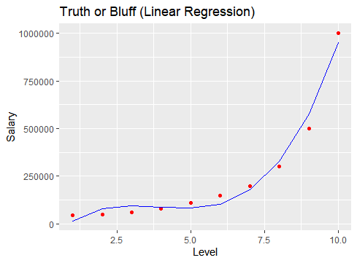
Overfitting
When a model is built using so many predictors that it captures noise along with the underlying pattern
It tries to fit the model too closely to the training data leaving very less scope for generalizability. This phenomenon is known as Overfitting.
Low bias error, High variance error
When the model has a low error rate in training data but a high error rate in testing data, we can say the model is overfitting the training data set
This usually happens when hyperparameters have been tuned to produce a low error rate on the training data.
Notes:
Think of a student who studied a certain set of questions and then gave a mock exam which contains those exact questions they studied. They might do well on the mock exam but on the real exam, which contains unseen questions, they might not necessarily do well. If the student gets a 95% in the mock exam but a 50% in the real exam, we can call it overfitting.

Slide 16
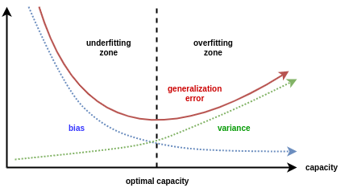
How to measure Generalization Error
bias-variance tradeoff, a well-known problem in machine learning which involves minimizing two sources of error which prevent supervised learning algorithms
from generalizing well to new data.
Good (minimum) value for the generalization error is the point where both the bias and variance are low

Slide 17
Measures for In-sample Evaluation
A good regression model is one where the difference between the actual or observed values and predicted values for the selected model is small and unbiased for train, validation and test data sets.
Below statistical measures are a way to numerically determine how good the model fits on our data.
1. Mean Absolute error
2. Root Mean Square error
3. R Squared
4. Adjusted R Sqaure

Slide 18
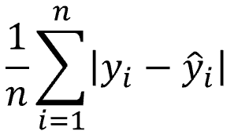
Mean Absolute error
This is the simplest of all the metrics
It is measured by taking the average of the absolute difference between actual values and the predictions.
Suppose we have model that predicted
The salary of 2 employees which are
10000,20000 where the actual salaries were
5000,10000
(10000-5000) +(20000-10000) 15000 7500 RS MSE = = 2 =
2
MAE =E

Slide 19
MAE value 75000 tells us that the model is predicting 75000 (RS) more or less on average than the actual values of salaries

Slide 20
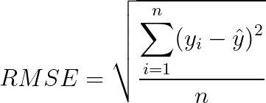
2. Root Mean Square Error(RMSE) This is the simplest of all the metrics
The Root Mean Square Error is measured by taking the square root of the average of the squared difference between the prediction and the actual value.
It represents the sample standard deviation of the differences between predicted values and observed values(also called residuals).
Both MAE and RMSE are in the same units as the dependent variable
As compared to MAE , RMSE have more impact of outliers

Slide 21
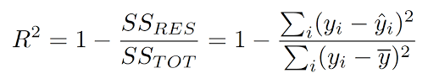
3. R Squared
R-squared is a statistical measure of how close the data are to the fitted regression line. It is also known as the coefficient of determination.
R-squared provides an estimate of the strength of the relationship between your model and the response variable
R-squared is also called as goodness of fit, which shows how well the data fit the regression model
SSR = Sum Square of Residuals(the squared difference between the observed and the predicted value)
SST = Sum Square of Total(the squared difference between the observed and average value)

Slide 22
4. Adjusted R Squared
Adjusted R2 is a corrected goodness-of-fit (model accuracy) measure for linear models. It identifies the percentage of variance in the target field that is explained by the input or inputs.
R2 tends to optimistically estimate the fit of the linear regression. It always increases as the number of independent variables(effects) are included in the model.
Adjusted R2 attempts to correct for this overestimation. Adjusted R2 might decrease if a specific independent variable( effect) does not improve the model.

Slide 23
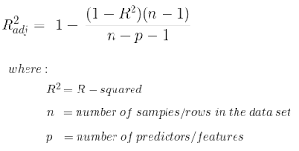

Slide 24
Model Selection
In machine learning, we usually select our final model after evaluating several candidate models, This process is called model selection.
Sometimes the models subject to comparison are fundamentally different in nature (say, decision trees vs. linear models).
Compare different model (fundamentally different in nature
Model Training
Model parameters
Build/train decision tree model
Compare accuracy of decision tree and linear regression model
Model parameters/equation for best model
Build/train linear regression model
Notes:
Parameters : When a model is being trained on a data set, it determines the best parameters for each predictor variable.
Ex. in a linear regression, where the coefficients are determined for each variable used in the model. The coefficients in this case are the parameters: they are found via the training process.

Slide 25
At other times, we are comparing members of the same class of models that have been trained with different hyperparameter settings.
A hyperparameter is a model argument whose value is set before the learning process begins.
To search and get the optimal values for hyperparamters is called as hyperparameter tuning
Hyper parameters
In-Sample Evaluation
Train Set
Model training
Data Set
out-Sample Evaluation
Test set
Model
Notes:
Ex. 1. The degree of order is hyperparameter of the polynomial regression model
In model comparison we can compare polynomial regression model with degree 2, 3 ,4 etc . And will select the model with good accuracy.
2. The decision tree has max depth and min number of observations in leaf as hyperparameters.
And we need to compare the various decision tree models built using different values of maximum depth and minimum number of observations to consider etc.
Three important aspects of making good model :
Type of model (Suitable to relationship between attributes linear, nonlinear etc)
Feature selection (selection of independent variables)
best hyperparameters to use (Hyperparameter tuning)

Slide 26
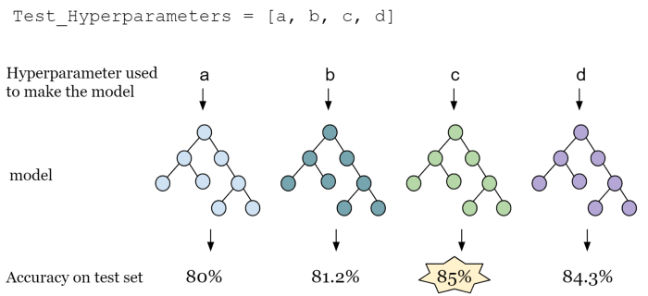
Optimal Hyperparameters: Hyperparameters control the over-fitting and under-fitting of the model. To get the best hyperparameters the following steps are followed:
1. For each proposed hyperparameter setting the model is evaluated
2. The hyperparameters that give the best model are selected.

Slide 27
Testing Multiple Parameters(Hyperparameter tuning) by using Grid Search
While doing hyperparameter tunning if we have more than one hyperparameter , Grid Search takes the model or objects you would like to train and different values of the hyperparameters
and given the model build using optimal values of hyperparameters which gives less error (MSE) /more R squared value
In short Grid search picks out a grid of hyperparameter values and evaluates all of them.

Slide 28
Model 1
(10,5)
Error 1 (0.2)
Hyperparameters
Maximum depth
( 10,20,30)
2. Minimum number of obervations
(5,6,7)
Hyperparameter maximum depth =30 and number of observations 7 can be selected
Grid Search
Model 2
(20,6)
Error 2 (0.3)
Model 3
(30,7)
Error 2 (0.1)

Slide 29
Cross Validation
Cross validation is a statistical technique used in machine learning to assess the performance of predictive model on unseen data
Cross validation divides the data in two parts one is train set and another is test set which is also called as validation set
This process of dividing data in two parts and training and validation of models is repeated multiple times , using different fold as the validation set
Performance metrics will be recorded for each iteration. After completion of all iterations average of performance metric of all iteration can provide more robust estimate of how well model will work on unseen data
The main purpose of cross validation is to prevent overfitting

Slide 30
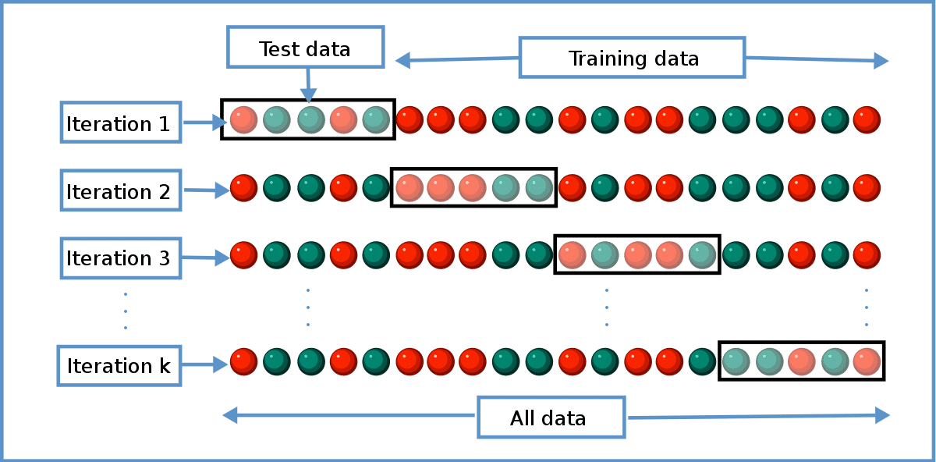
Cross Validation

Slide 31
Ensemble learning and bagging will be covered once all models of supervised learning are completed

